Slide 1
Talking Differentiation
Chris Chivers
@chrischivers2
chrischiversthinks.weebly.com

Slide 2
What is your current understanding of the term Differentiation?
Discuss and share; to consider again at the end.

Slide 3
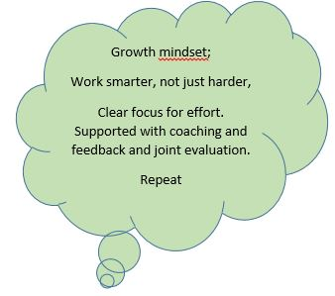
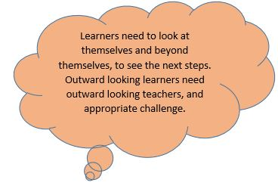
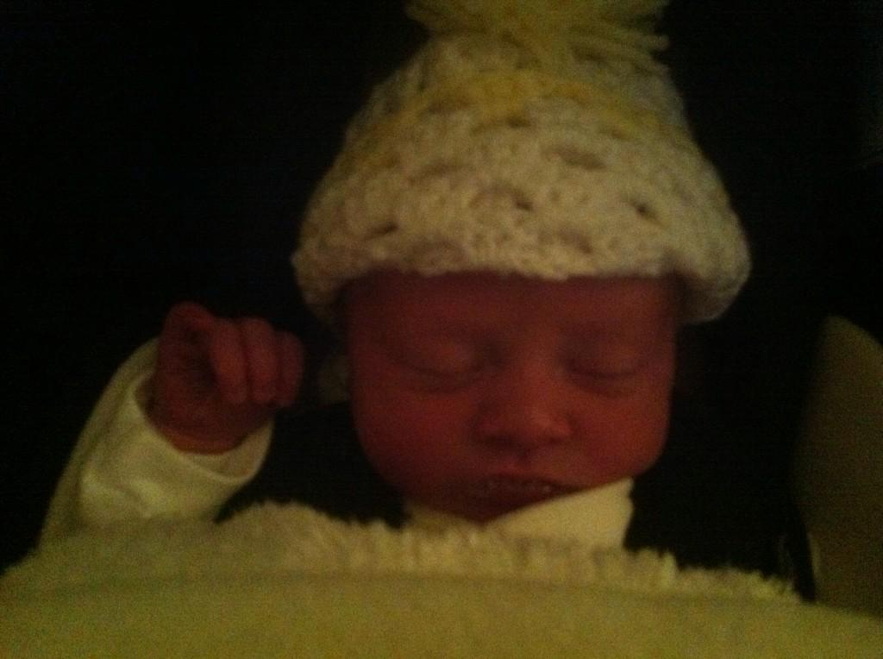
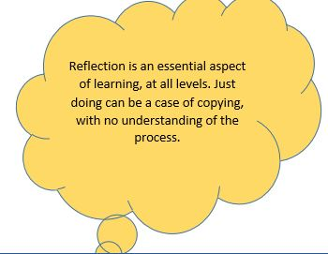
It all starts by knowing your children, well.

Slide 4
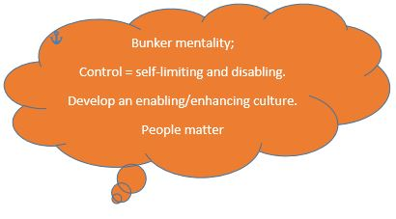
Look up, down, round. In life we make judgements. What you see might depend on your personal viewpoint, based on your life experiences.

Slide 5
The way you think matters. Is it FORmative and inFORmative? FOR=Frame of Reference
Feedback Response, comment, reaction
Opinion Belief, assumption, conjecture, hypothesis, speculation
Review Critique; summary, discuss, inspect, recap, redraft.
Measurement Calculation, capacity, quantification
Appreciation Recognition, enjoyment, esteem, liking, understanding
Test Examination, quiz, check, inquire, probe, verify.
Investigation Assay, analysis, evaluation, measurement, rating
Value Worth
Estimation Belief, guess, opinion, prediction

Slide 6
Decisions, decisions

Slide 7
24652

Slide 8
Take five children…

Slide 9
24652

Slide 10
24652

Slide 11
Starting with expectation. What if your planning was a prediction, or a hypothesis?
Are you a script writer or a lesson director, writing dynamic notes?
Would a change of planning change the lesson dynamics?
If your plans became anticipatory, would that affect your in-lesson behaviour?
Do you go into the classroom with an expectation, or a delivery mindset?
Have you anticipated alternative scenarios?
What, specifically, are you looking out for within the lesson?
Are you “thinking on your feet”; Teaching Standard 6
Do you adapt to evident need in the lesson; TS 5.

Slide 12
Differentiation by
Outcome- whole class teaching; stratification at the end from top to bottom
Support- whole class teaching; allocated adult to support group. (SEN issues?)
Support- resources adapted to need, eg concrete apparatus, ICT.
Low level task expectation 1, eg all must, most will, some could. If known that “some could”, who are they and is expectation high enough?
Low level task expectation 2, different levels of challenge to work through. How much is needed before progression? Does this slow able children?
High level task, tailored to the needs of the group, within which individual challenge also possible.

Slide 13
Differentiation by TS 6&5
More personalised responses…
Match and challenge
Modelling; concrete, pictorial, diagrammatic, oral rehearsal.
Differential input / teaching to need. “Breakaway” groups.
Expectation.
Spotting and dealing with visible learning behaviours suggesting an issue.
Adapting the challenge within a task to evident needs within a lesson.
Guidance, coaching and feedback at an individual level.
Marking that is based on the learner need, evident from outcomes.
Adaptations between lessons.
Personalised home supported activity?
3G assessment system; get it, got it, good… and vice versa (food for thought)

Slide 14
Classroom practice Task setting, or activity setting?
Consider differentiation as match and challenge?
Do the tasks you set match and challenge the learners?
Or do they limit them to embedding practice?
What is the right balance of practice and development in tasking?
Do your working practices embed differential challenge , or might they limit (some) learners?
Eg Consider books with inappropriate line spacing?

Slide 15
Visible target setting
Put personalised targets on a fold out slip, at the edge of the exercise book, so that during the lesson, the child and the teacher can be aware of the specific targets.
This can prompt conversations specific to that child, support the learner’s self-evaluations and also support teacher oral and written feedback, as the slips can be folded out during marking.
Targets can be achieved , then become non-negotiable in future work, with new ones added.
This approach also supports record keeping, as the slip forms an on-going record of achievement.

Slide 17
Make marking interactive
The first rule of Mark Club- Marking is an essential part of the continuing learning dialogue between the teacher and the learner.
The second rule of Mark Club- where possible get the learner to guide your marking to their learning needs. Get the learners to identify positive points and insecurities.
The third rule of Mark Club- It can be continuous and formative, or at discrete points and summative. Either way, it is part of a supportive, developmental process.
The fourth rule of Mark Club- all marking must promote further learning. If it doesn’t have follow-up and impact, it may not be worth it….
The fifth rule of Mark Club- create a response time, to allow learners to read and react to prior needs.

Slide 18
Marking for impact
Does your marking develop a learning dialogue with the child?
Can they read what you have written?
Do you use a marking code? Is it known well by the children?
How do they respond to your marking?
Is it a development point, or a mistake?
WWW, EBI? Stars and wishes.
Deep marking or spotting?
Do you use DIRT time, or similar?
Dedicated
Improvement and
Response
Time
When does this happen?
Do you embed draft/redraft in your everyday practice, as a personalised response?

Slide 19
While the teacher is always the “responsible adult” in a room, how do the additional adults support differentiation and assessment?
Observers? Sharing the spotter role in a classroom?
Are learning instructions/plans sufficiently clear to enable the additional adult to operate independently, within known parameters?
Does the additional adult feed back orally or in writing to the teacher after the session, to support post-lesson reflection?
Is the additional adult involved in any aspect of record passing or keeping?
Is the additional adult involved in any aspect of lesson planning?
Does the teacher, as the “responsible adult” know, and take responsibility for, exactly what is happening in an “intervention” group?

Slide 20
What about specific individuals?

Slide 21
All teachers are teachers of SEND; crib sheet

Slide 22
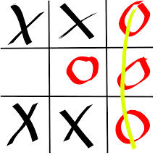
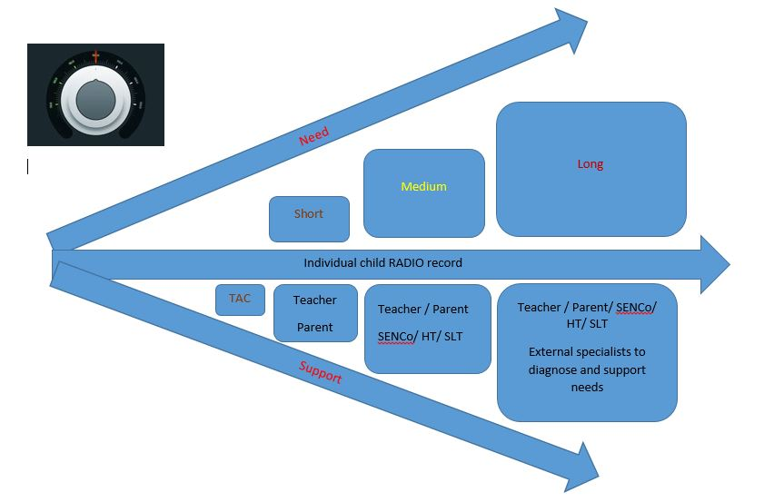
Record keeping
Good record keeping supports reflection.
Annotated working plans, at medium or short term.
Individual case study notes, supported by TA notes.
Checking against tracker progress? Adjustments?
Summative reporting to SENCo, HT, Parents?

Slide 23
And it’s all in the Teacher Standards!

Slide 24
Reprise

Slide 25
Differentiation
Each and every child receives the quality of education and support that they need to make good progress in their learning.

